Slide 1





PRESENTATION 2026
Student Name
Student Email
Ruthuja Babar
ruthujababar@gmail.com
Mentor Name
Umamaheswari

Slide 2

Outline
Abstract of the Project
Problem Statement
Proposed Solution
System Architecture
Conclusion
Future scope
Reference

Slide 3
Abstract
Clean and organize data using Microsoft Excel
Analyse healthcare data with Microsoft Power BI
Track KPIs: Total patients, Total Revenue, Average Stay, Recovery Rate, Department Count.
Use interactive dashboards for real-time insights
Improve efficiency, accuracy, and patient care quality

Slide 4

Problem Statement
Data is incomplete and unstructured
No real-time visibility
Manual work causes errors
Slow and inconsistent reports
Need data cleaning & organization
Track health metrics easily
Monitor patient flow & workload
Improve efficiency and decisions
Ensure better patient care

Slide 5
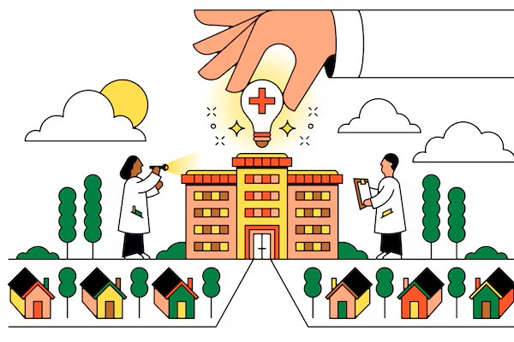
Proposed Solution
Data Collection & Integration
Data Cleaning
Data Modeling
Dashboard Design Deployment

Slide 6
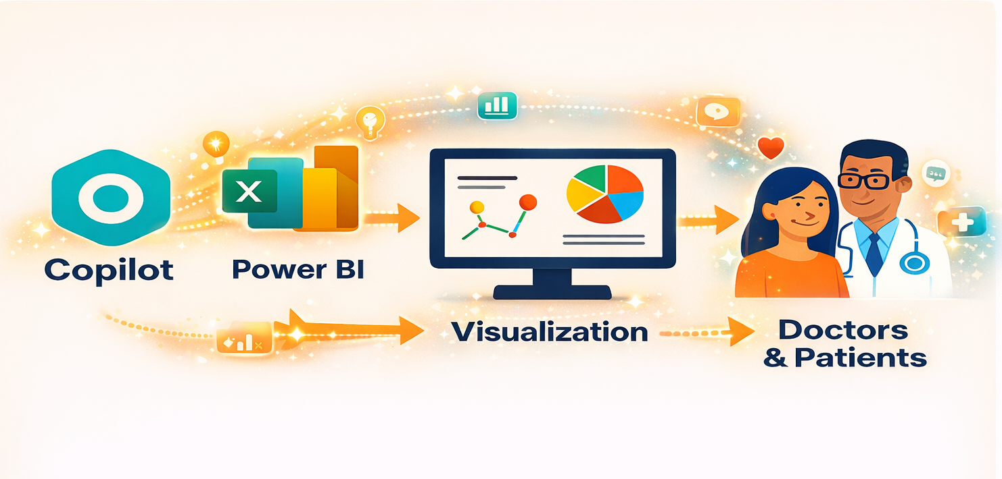
System Architecture

Slide 7
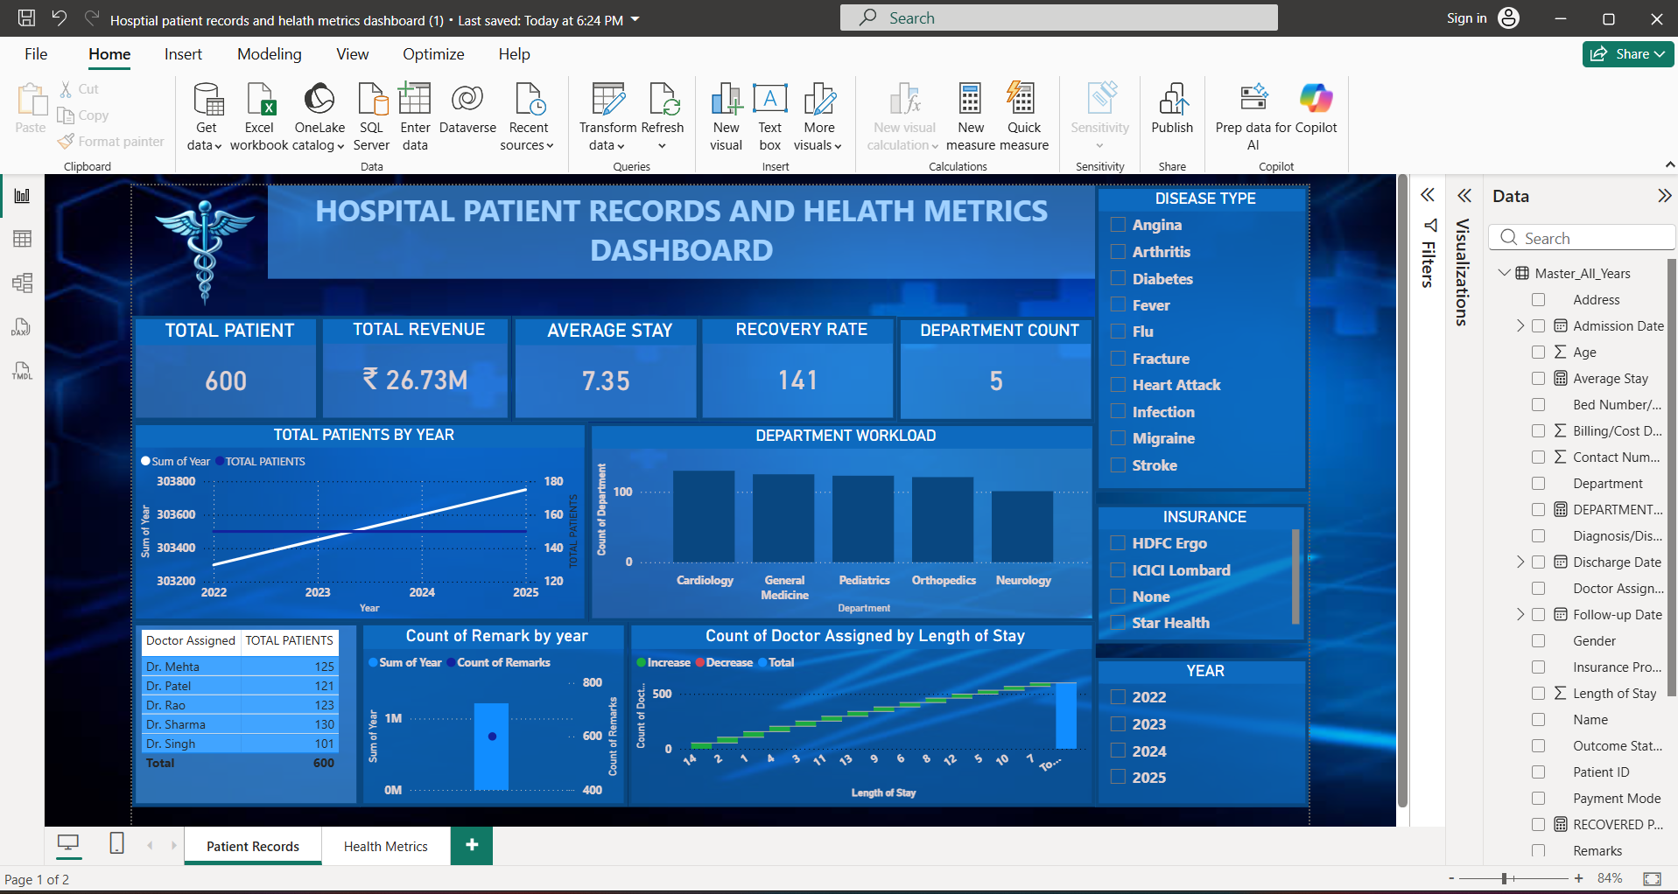
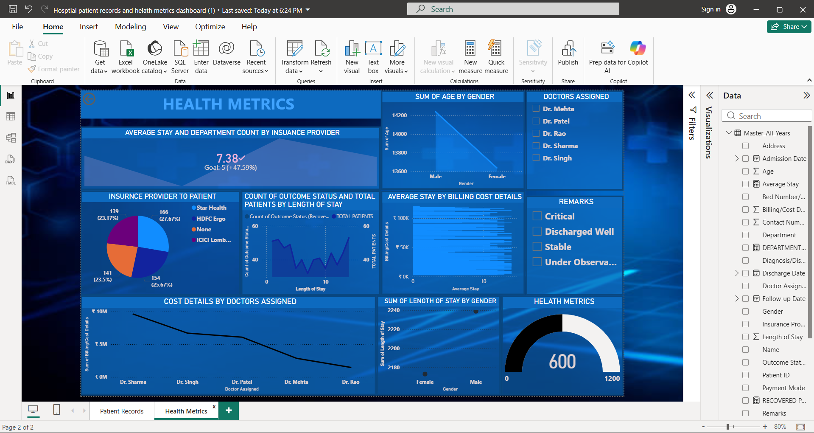
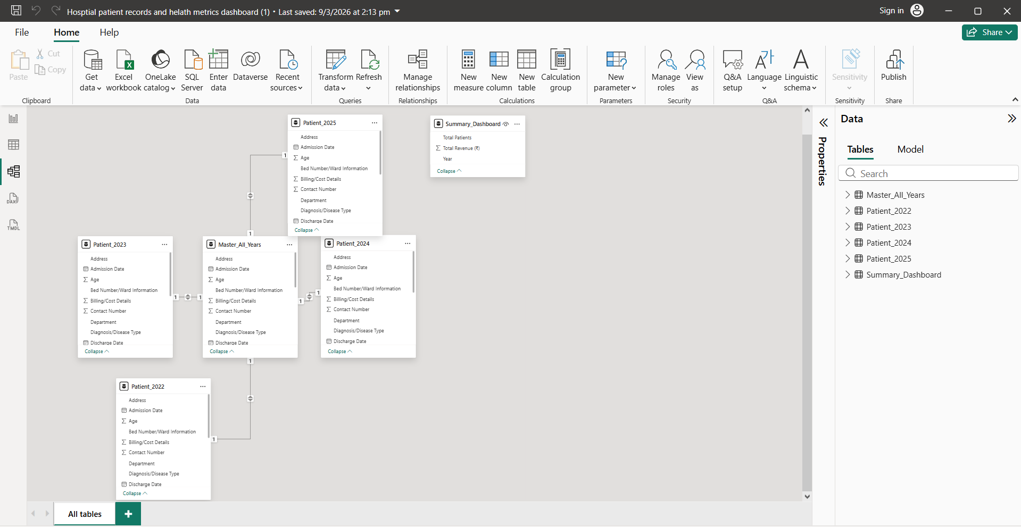
Live Demo of Project

Slide 8
Video of Project Demo
[https://your-project-demo-link.com]
▶
[Insert your project demo video.
You can embed a video your live project.]

Slide 9


Conclusion
Successfully cleaned and structured hospital patient data
Built interactive dashboards using Microsoft Power BI
Enabled real-time monitoring of KPIs and hospital performance
Improved decision-making, efficiency, and patient care quality

Slide 10


Future Scope
Integrate Microsoft Power BI for real-time data updates
Enable live dashboards for instant monitoring
Use predictive analytics for patient risk forecasting
Provide mobile access for doctors and admins
Set alerts for beds, critical cases, and resources
Ensure role-based access and data security
Maintain patient data privacy and protection

Slide 11
Thank You
AICW Fellowship | Student Project Presentation 2026
LinkedIn | Edunet Foundation

